Slide 1
Classification of a VAE /VAP using 2025 CDC guidelines/Checklists

Slide 2
VAE surveillance
Inclusion and Exclusion Criteria Patients INCLUDED in VAE surveillance:
All patients in the adult inpatient locations found in Chapter 15, regardless of patient’s age • Patients on a ventilator (as defined below) who are receiving: o a conventional mode of mechanical ventilation (for example, synchronized intermittent mandatory ventilation) o Airway Pressure Release Ventilation (APRV) or related modes (see “Frequently Asked Questions [FAQ]” numbers [nos.] 18 and 19 at the end of this protocol) • Patients on a ventilator (as defined below) who are receiving a conventional mode of mechanical ventilation, or APRV or related modes: o while in the prone position o while receiving nitric oxide therapy, helium-oxygen mixtures (heliox), or epoprostenol therapy Patients
EXCLUDED from VAE surveillance: • All patients in the neonatal and pediatric inpatient locations found in Chapter 15, regardless of patient’s age • Patients on high-frequency ventilation, extracorporeal life support, or paracorporeal membrane oxygenation are excluded from VAE surveillance during periods of time when the support is in place for the entire calendar day (see FAQ no. 18 at the end of this protocol

Slide 3
Definitions
Ventilator:
A device used to support, assist, or control respiration (inclusive of the weaning period) through the application of positive pressure to the airway when delivered via an artificial airway, specifically oral/nasal endotracheal or tracheostomy tube. Ventilation and lung expansion devices that deliver positive pressure to the airway (for example, CPAP, BiPAP, Bi-level, IPPB, and PEEP) via non-invasive means (for example, nasal prongs, nasal mask, full face mask, total mask, etc.) are not considered ventilators unless positive pressure is delivered via an artificial airway (oral/nasal endotracheal or tracheostomy tube)
VAE:
VAEs are identified by using a combination of objective criteria: deterioration in respiratory status after a period of stability or improvement on the ventilator, evidence of infection or inflammation, and laboratory evidence of respiratory infection, and are categorized into the following 3 tiers: ventilator associated condition (VAC), infection-related ventilator-associated complication (IVAC), and possible ventilator-associated pneumonia (PVAP). The following pages outline the criteria that must be used for meeting each of the VAE surveillance definitions (Figure 1). Patients must be mechanically ventilated for at least 4 calendar days to fulfill VAE criteria (where the day of intubation and initiation of mechanical ventilation is day 1). The earliest date of event for VAE (the date of onset of worsening oxygenation) is day 3 of mechanical ventilation. Line lists of VAE data elements demonstrating scenarios that meet and do not meet the VAE definitions are presented in FAQ no. 2 at the end of this protocol

Slide 4
Definitions continues
Positive End-Expiratory Pressure (PEEP):
“A technique used in respiratory therapy in which airway pressure greater than atmospheric pressure is achieved at the end of exhalation by the introduction of a mechanical impedance to exhalation” [19]. In patients on mechanical ventilation, PEEP is one of the key parameters that can be adjusted depending on the patient’s oxygenation needs and is typically in the range of 0 to 15 cmH2O. A sustained increase in the daily minimum PEEP of ≥ 3 cmH2O following a period of stability or improvement on the ventilator is one of two criteria that can be used in meeting the VAC definition. For the purposes of VAE surveillance, PEEP values from 0 to 5 cmH2O are considered equivalent.
Fraction of Inspired Oxygen (FiO2):
The fraction of oxygen in inspired gas. For example, the FiO2 of ambient air is 0.21; the oxygen concentration of ambient air is 21%. In patients on mechanical ventilation, the FiO2 is one of the key parameters that can be adjusted depending on the patient’s oxygenation needs and is typically in the range of 0.30 (oxygen concentration of 30%) to 1.0 (oxygen concentration of 100%). A sustained increase in the daily minimum FiO2 of ≥ 0.20 (20 points) following a period of stability or improvement on the ventilator is one of the two criteria that can be used in meeting the VAC definition

Slide 5
Definitions continued
Daily Minimum PEEP:
The lowest value of PEEP during a calendar day that is set on the ventilator and maintained for > 1 hour. This requirement that the daily minimum PEEP be the lowest setting maintained for > 1 hour will ensure that units monitoring and recording PEEP settings hourly or more frequently than once per hour are able to apply the VAE surveillance PEEP criterion in a standardized way. If ventilator settings are monitored and recorded less frequently than once per hour (for example, every 2 hours or every 4 hours), the daily minimum PEEP is simply the lowest value of PEEP set on the ventilator during the calendar day
Daily Minimum FiO2:
The lowest value of FiO2 during a calendar day that is set on the ventilator and maintained for > 1 hour. This requirement that the daily minimum FiO2 be the lowest setting maintained for > 1 hour will ensure that units monitoring and recording FiO2 settings hourly or more frequently than once per hour are able to apply the VAE surveillance FiO2 criterion in a standardized way. If ventilator settings are monitored and recorded less frequently than once per hour (for example, every 2 hours or every 4 hours), the daily minimum FiO2 is simply the lowest value of FiO2 set on the ventilator during the calendar day
To meet the criteria for daily minimum PEEP or FIO2 the reading must be maintained for 2 consecutive hours.

Slide 6
Definitions continued
Period of Worsening Oxygenation:
The period of worsening oxygenation is defined as an increase in the daily minimum FiO2 of at least 0.20 (20 points) over the daily minimum FiO2 of the first day in the baseline period or an increase in the daily minimum PEEP values of at least 3 cmH2O over the daily minimum PEEP of the first day in the baseline period, that immediately follows the baseline period and is sustained for at least 2 or more calendar days.
VAE Window Period:
This is the period of days around the date of event (specifically the day of onset of worsening oxygenation) within which other VAE criteria must be met. It is usually a 5-day period and includes the 2 days before, the day of, and the 2 days after the VAE date of event. There is an exception, however, in which the VAE Window Period is only 3 or 4 days, as follows: In cases where the VAE date of event corresponds to mechanical ventilation (MV) day 3 or day 4, the window period described above may only be a 3-day or a 4-day window, because it can NOT include any days before the third day of MV. For example, if the VAE date of event is MV day 3, then the window period includes only the VAE date of event and the 2 days after the VAE date of event (because the 2 days before the VAE date of event are before the third day of MV)

Slide 7
Definitions continued
14-day Event Period: VAEs are defined by a 14-day period, starting on the day of onset of worsening oxygenation (the date of event, day 1). While patients may have multiple VAEs during a single hospitalization, a new VAE cannot be identified or reported until this 14-day period has elapsed. VAE criteria met during the 14-day period are attributed to the current
New Antimicrobial Agent:
Defined as any agent listed in the Appendix that is initiated on or after the third calendar day of mechanical ventilation AND in the VAE Window Period (specifically, the period typically defined by the 2 calendar days before, the day of, and the 2 calendar days after the onset date of the VAE). The agent is considered new for the purposes of this definition if it was NOT given to the patient on either of the 2 days preceding the current start date
Purulent Respiratory Secretions:
Defined as secretions from the lungs, bronchi, or trachea that contain ≥ 25 neutrophils and ≤ 10 squamous epithelial cells per low power field [lpf, x100]. Some clinical laboratories may use different results reporting formats for direct examinations of respiratory secretions. Additional instructions for using the purulent respiratory secretions criterion are provided in Table 2, below (see also FAQ no. 15 at the end of this protocol).

Slide 8
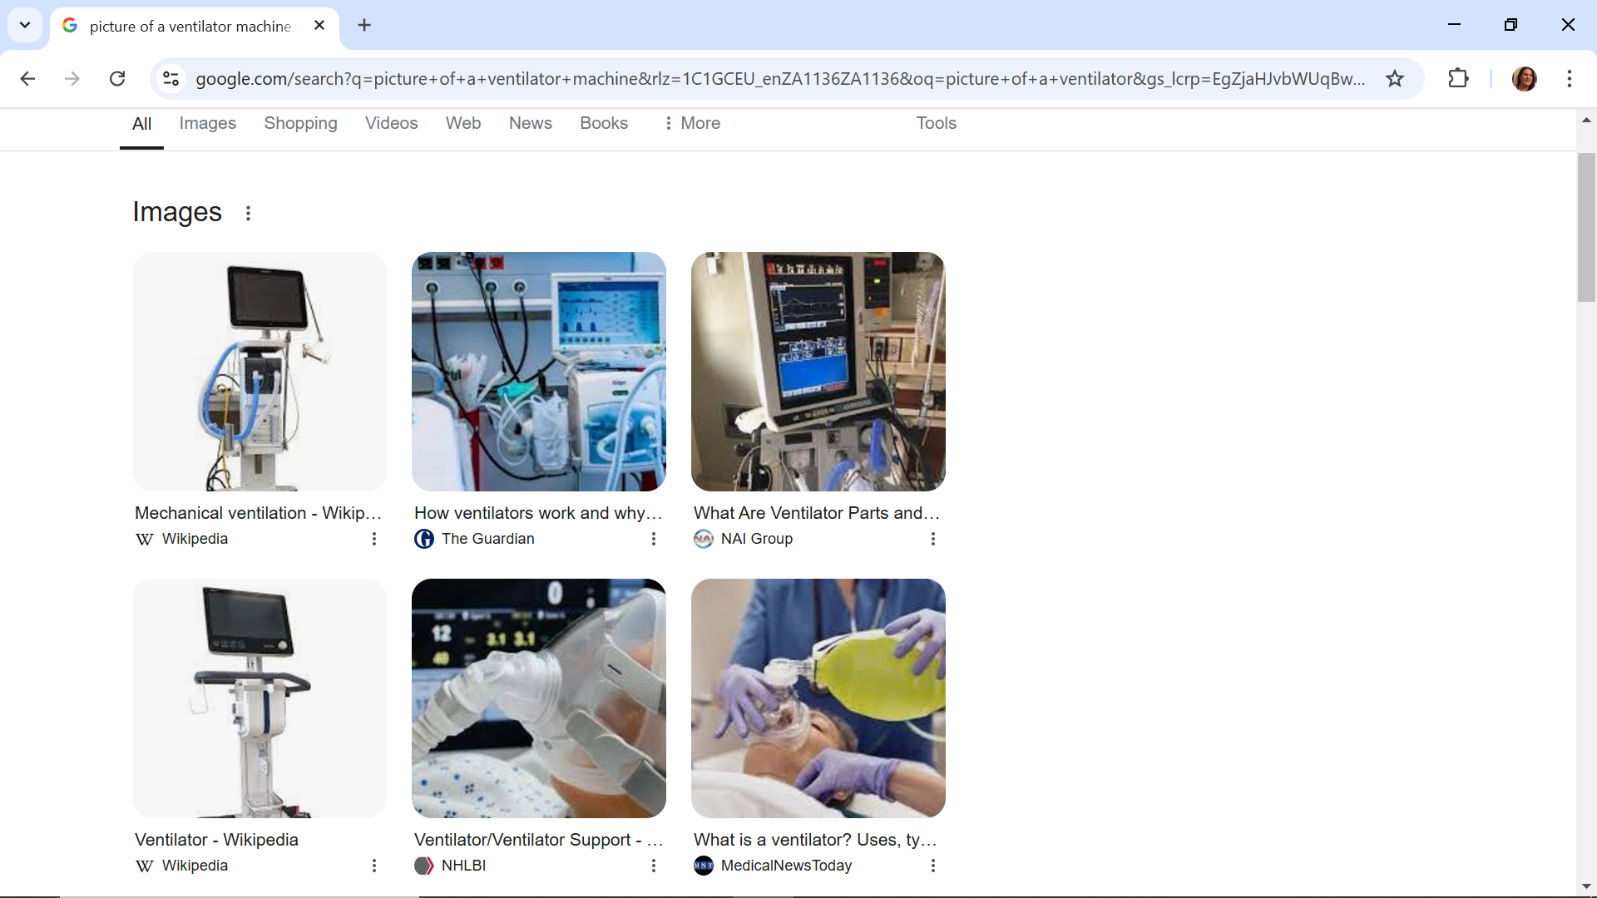
Ventilator-Associated Condition (VAC)
Stability or improvement is defined by ≥ 2 calendar days of stable or decreasing daily minimum FiO2 or PEEP values. The baseline period is defined as the 2 calendar days immediately preceding the first day of increased daily minimum PEEP or FiO2.
**Daily minimum defined by lowest value of FiO2 or PEEP during a calendar day that is maintained for > 1 hour.
Daily minimum PEEP values of 0-5 cm H2O are considered equivalent for the purposes of VAE surveillance
AND immediately following a period of stability or improvement (as above), patient has at least one of the following indicators of worsening oxygenation:
1. Increase in daily minimum** FiO2 of ≥ 0.20 (20 points) over daily minimum FiO2 of the first day in the baseline period, sustained for ≥ 2 calendar days
2. Increase in daily minimum** PEEP values of ≥ 3 cm H2O† over daily minimum PEEP of the first day in the baseline period, sustained for ≥ 2 calendar days
Go to your ICU chart . What made you suspect a VAP? If specimen look if within 5 day infection window you had 2 days of improvement /stability and then increased PEEP or FiO2.

Slide 9
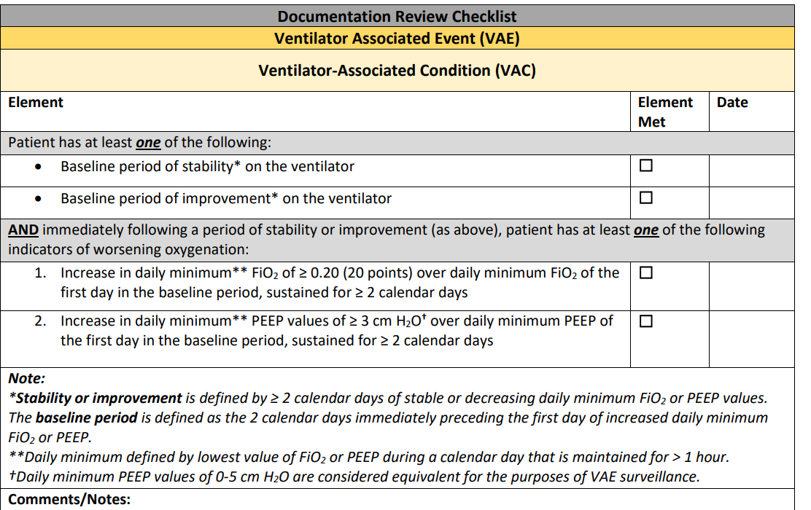
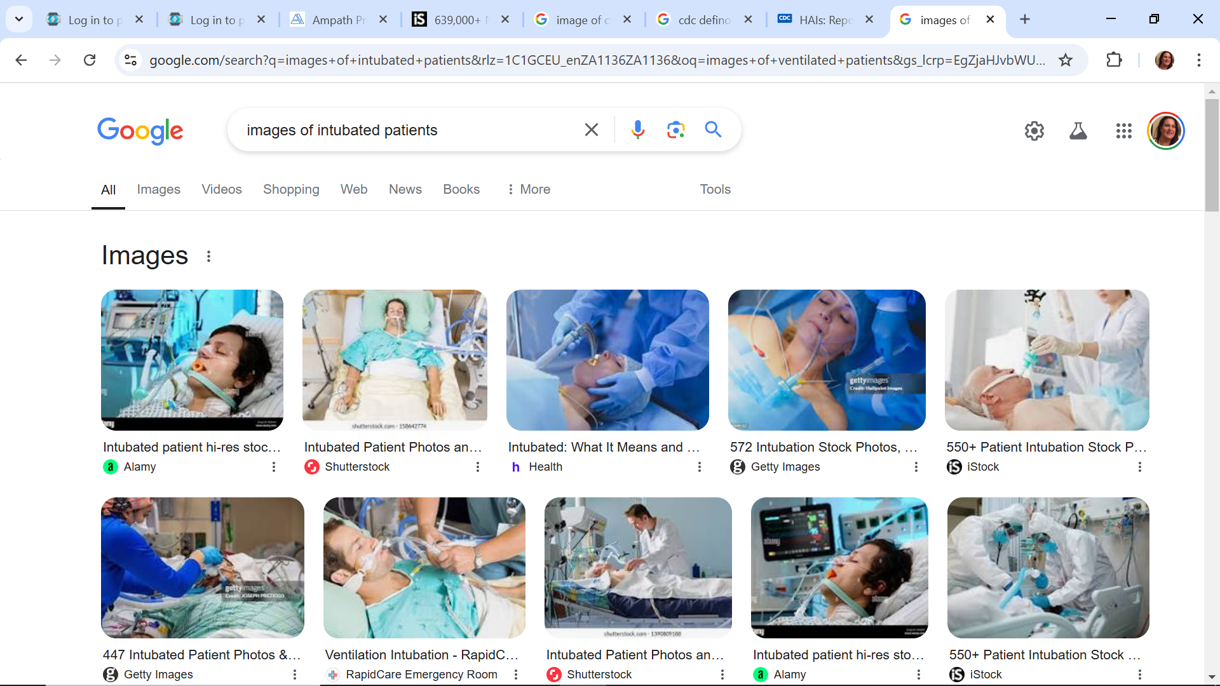
2025 NHSN Ventilator-Associated Event (VAE) Checklist

Slide 10
Pediatric ventilator associated event
Patients INCLUDED in PedVAE surveillance: •
All patients in the neonatal and pediatric inpatient locations found in Chapter 15, regardless of patient’s age • Patients on a ventilator (as defined below) who are receiving o a conventional mode of mechanical ventilation (for example, synchronized intermittent mandatory ventilation) o high-frequency oscillatory or jet ventilation •
Patients EXCLUDED from PedVAE surveillance: • All patients in the adult inpatient locations found in Chapter 15, regardless of patient’s age • Patients on extracorporeal life support or paracorporeal membrane oxygenation are excluded from PedVAE surveillance during periods of time when the support is in place for the entire calendar day
PedVAE: PedVAEs
are identified by deterioration in respiratory status after a period of stability or improvement on the ventilator (Figure 1). Patients must be mechanically ventilated for at least 4 calendar days to fulfill PedVAE criteria (where the day of intubation and initiation of mechanical ventilation is day 1).

Slide 11
Pediatric ventilator associated event
Mean Airway Pressure (MAP):
The average pressure exerted on the airway and lungs from the beginning of inspiration until the beginning of the next inspiration [21]. In patients on mechanical ventilation, MAP is the most powerful influence on oxygenation and is determined by positive end-expiratory pressure (PEEP), peak inspiratory pressure (PIP), inspiratory time, and frequency [22]. A sustained increase in the daily minimum MAP of ≥ 4 cmH2O following a period of stability or improvement on the ventilator is one of two criteria that can be used in meeting the PedVAE definition.
Daily Minimum MAP:
The lowest value of MAP during a calendar day. For the purposes of surveillance: • When determining the daily minimum MAP value, round MAP values in the following manner: a MAP of 10.00 – 10.49 is rounded to 10 and a MAP of 10.50 – 10.99 is rounded to 11. For example, a patient who is intubated and started on mechanical ventilation at 21:30 on June 1, with a MAP of 10.35 cmH2O at 21:30 and a MAP of 10.54 cmH2O at 23:30 would have a daily minimum MAP of 10 cmH2O on June 1. •
In patients < 30 days old, MAP values of 0-8 cmH2O are considered equivalent; therefore, any day on which the daily minimum MAP was 0-8 cmH2O would be assigned a daily minimum value of 8 cmH2O.
• In patients ≥ 30 days old, MAP values of 0-10 cmH2O are considered equivalent; therefore, any day on which the daily minimum MAP was 0-10 cmH2O would be assigned a daily minimum value of 10

Slide 12
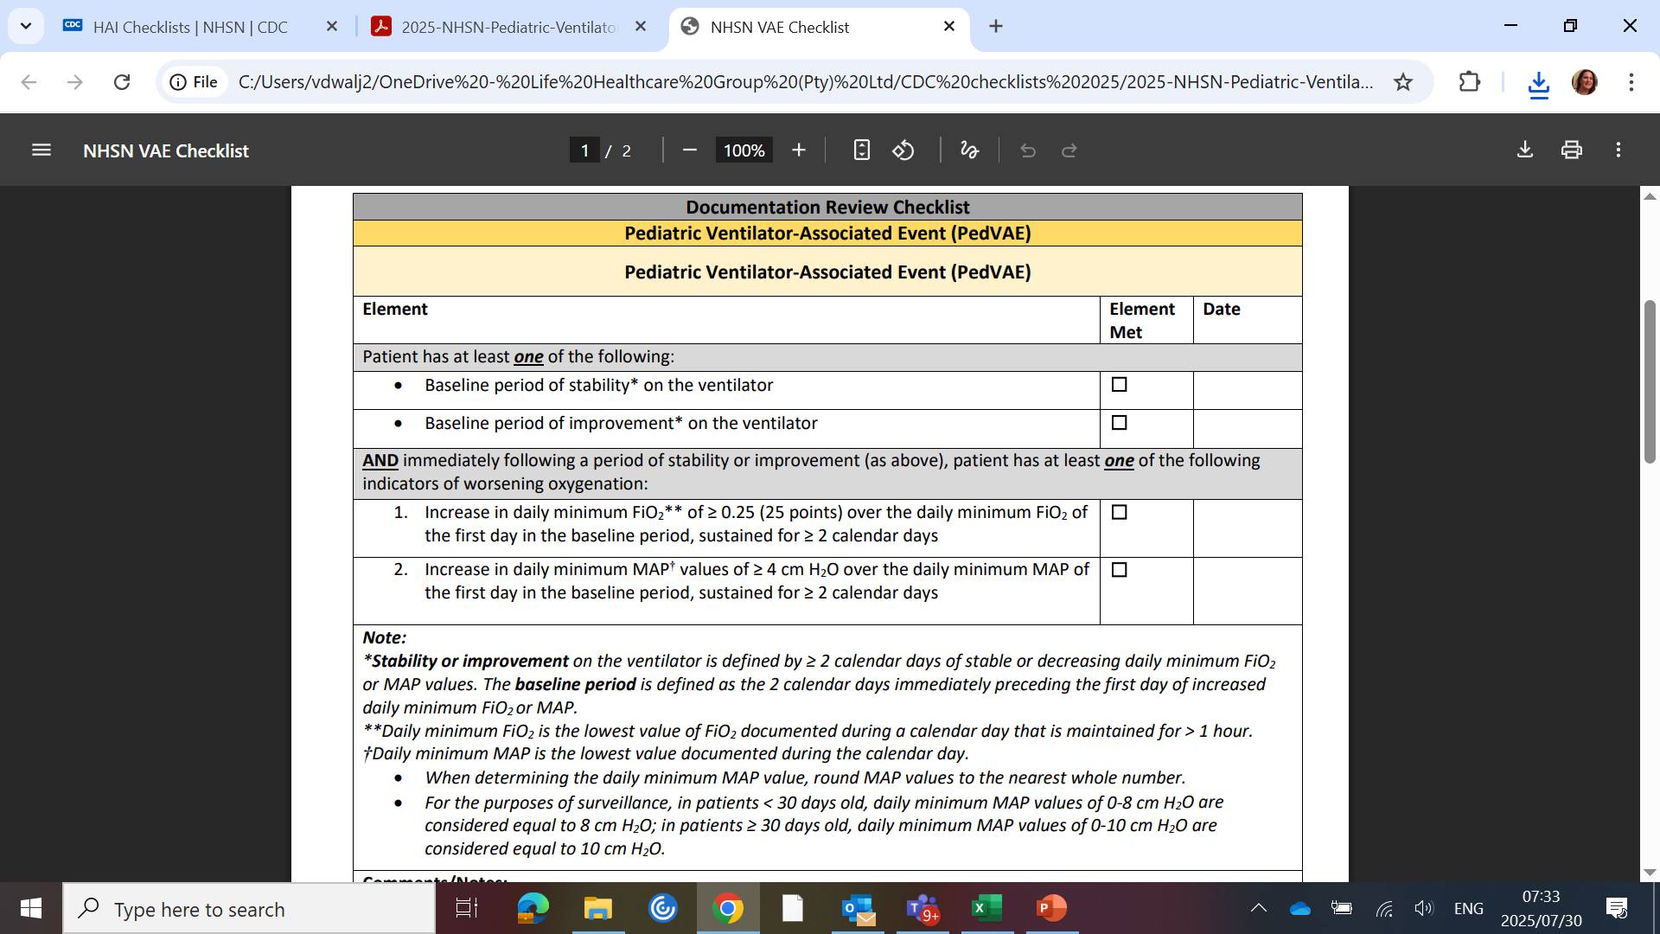
2025 NHSN Pediatric Ventilator-Associated Event (PedVAE) Checklist

Slide 13

Infection-related Ventilator-Associated Complication (IVAC)
On or after calendar day 3 of mechanical ventilation (MV) and within 2 calendar days before or after the onset of worsening oxygenation, the patient meets both 1 and 2:
1) Patient has one of the following:
Temperature > 38°C (>100.4°F) – Check ICU chart
Temperature < 36°C (<96.8°F) - Check ICU chart
White blood cell count ≥ 12,000 cells/mm3 – Check on ICNET
White blood cell count ≤ 4,000 cells/mm3 – Check on ICNET
AND
2) Patient meets both of the following:
A new antimicrobial agent(s)* is started
The new antimicrobial agent(s)** is continued for ≥ 4 qualifying antimicrobial day
(check on prescription chart?ICNET)

Slide 14
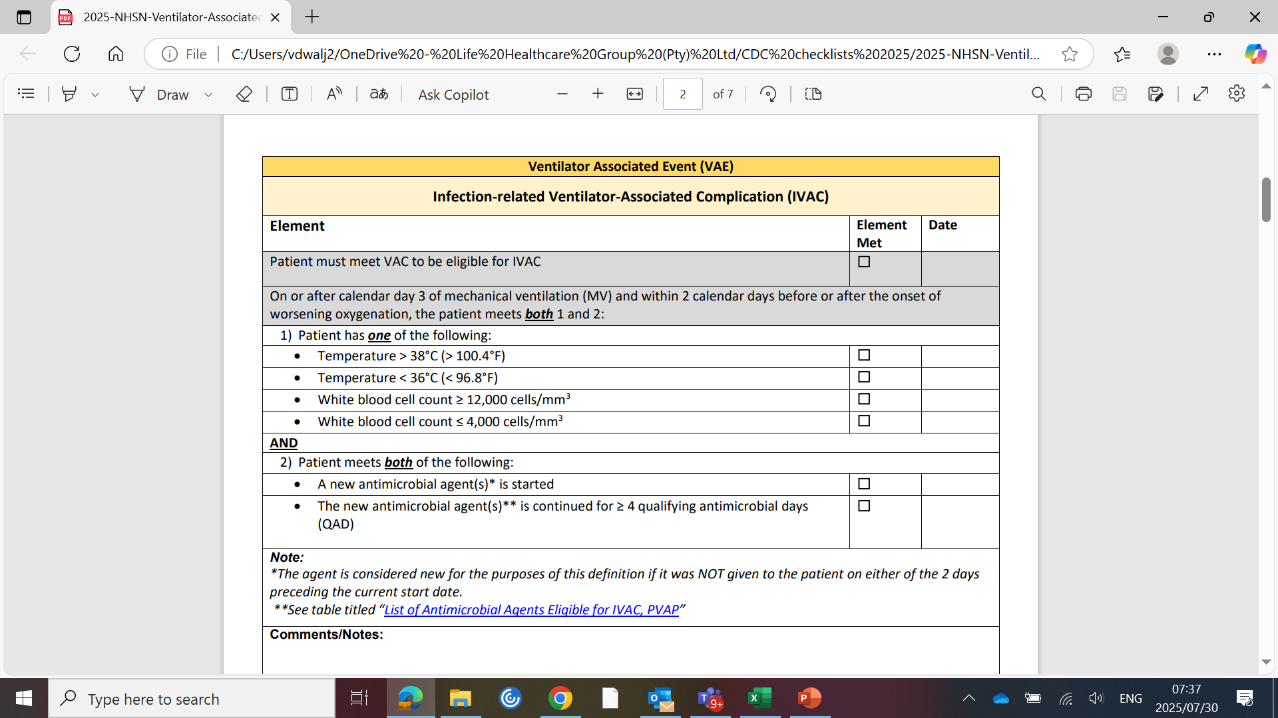

Slide 15
Possible Ventilator-Associated Pneumonia (PVAP)
AND Patient must meet one of following criteria on or after calendar day 3 of MV and within 2 calendar days before or
after the onset of worsening oxygenation (Refer to VAE Protocol for organisms excluded from meeting PVAP):
Criterion 1: Positive culture of one of the following specimens, meeting quantitative or semi-quantitative†
thresholds as outlined in protocol, without requirement for purulent respiratory secretions:
Endotracheal aspirate, ≥ 105 CFU/ml or corresponding semi-quantitative result
Bronchoalveolar lavage, ≥ 104 CFU/ml or corresponding semi-quantitative result
Lung tissue, ≥ 104 CFU/g or corresponding semi-quantitative result
Protected specimen brush, ≥ 103 CFU/ml or corresponding semi-quantitative result
2. Criterion 2: Purulent respiratory secretions (defined as secretions from the lungs, bronchi, or trachea
that contain ≥ 25 neutrophils and ≤ 10 squamous epithelial cells per low power field [lpf, x100])† PLUS
organism identified from one of the following specimens (to include qualitative culture, o
r quantitative/semi-quantitative culture without sufficient growth to meet Criterion 1):
Sputum
Endotracheal aspirate
Bronchoalveolar lavage
Lung tissue
Protected specimen brush
3. Criterion 3: One of the following positive tests:
Organism identified from pleural fluid (where specimen was obtained during thoracentesis or
within 24 hours of chest tube placement; pleural fluid specimens collected after a chest tube is repositioned
or from a chest tube in place > 24 hours are not eligible for PVAP)

Slide 16
PVAP
3. Criterion 3: One of the following positive tests:
1. Organism identified from pleural fluid (where specimen was obtained during thoracentesis or
within 24 hours of chest tube placement; pleural fluid specimens collected after a chest tube is repositioned or from a chest tube in place > 24 hours are not eligible for PVAP)
2. Lung histopathology, defined as: 1) abscess formation or foci of consolidation with intense neutrophil accumulation in bronchioles and alveoli; 2) evidence of lung parenchyma invasion by fungi (hyphae, pseudohyphae or yeast forms); 3) evidence of infection with the viral pathogens listed below based on results of immunohistochemical assays, cytology, or microscopy performed on lung tissue
3. Diagnostic test for Legionella species
•4. Diagnostic test on respiratory secretions for influenza virus, respiratory syncytial virus, adenovirus, parainfluenza virus, rhinovirus, human metapneumovirus, corona2.

Slide 17
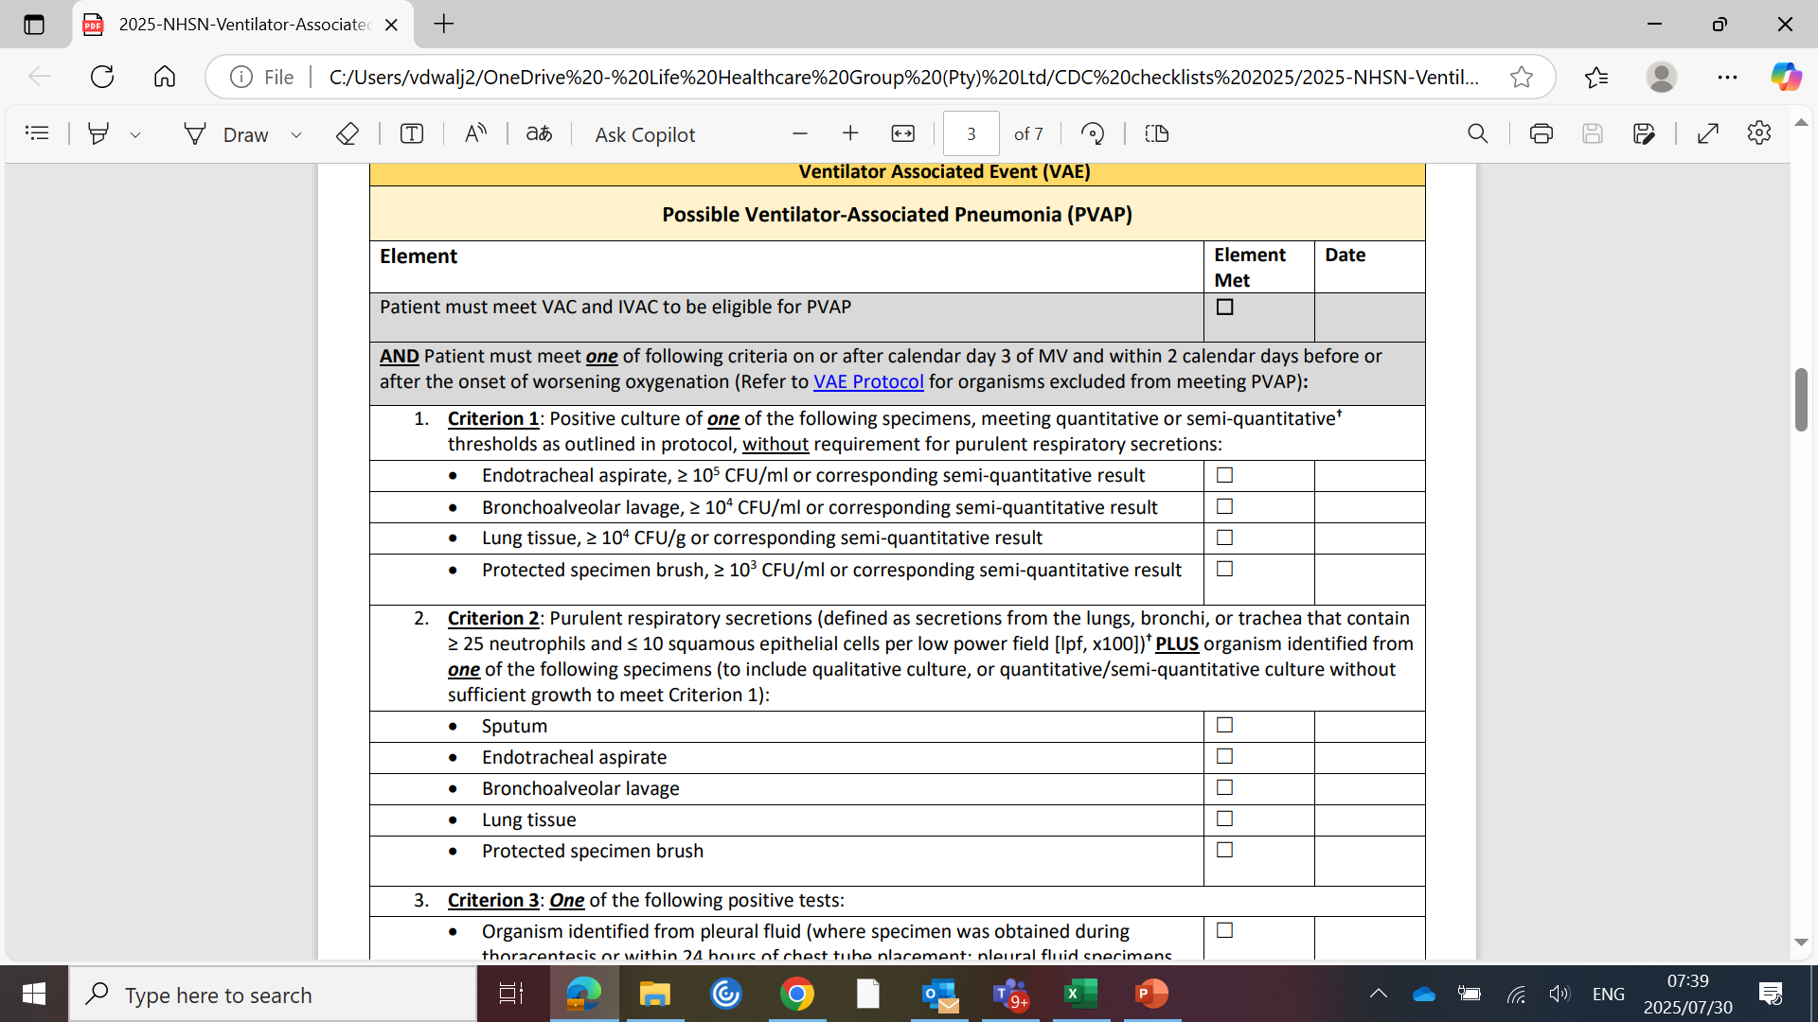

Slide 18
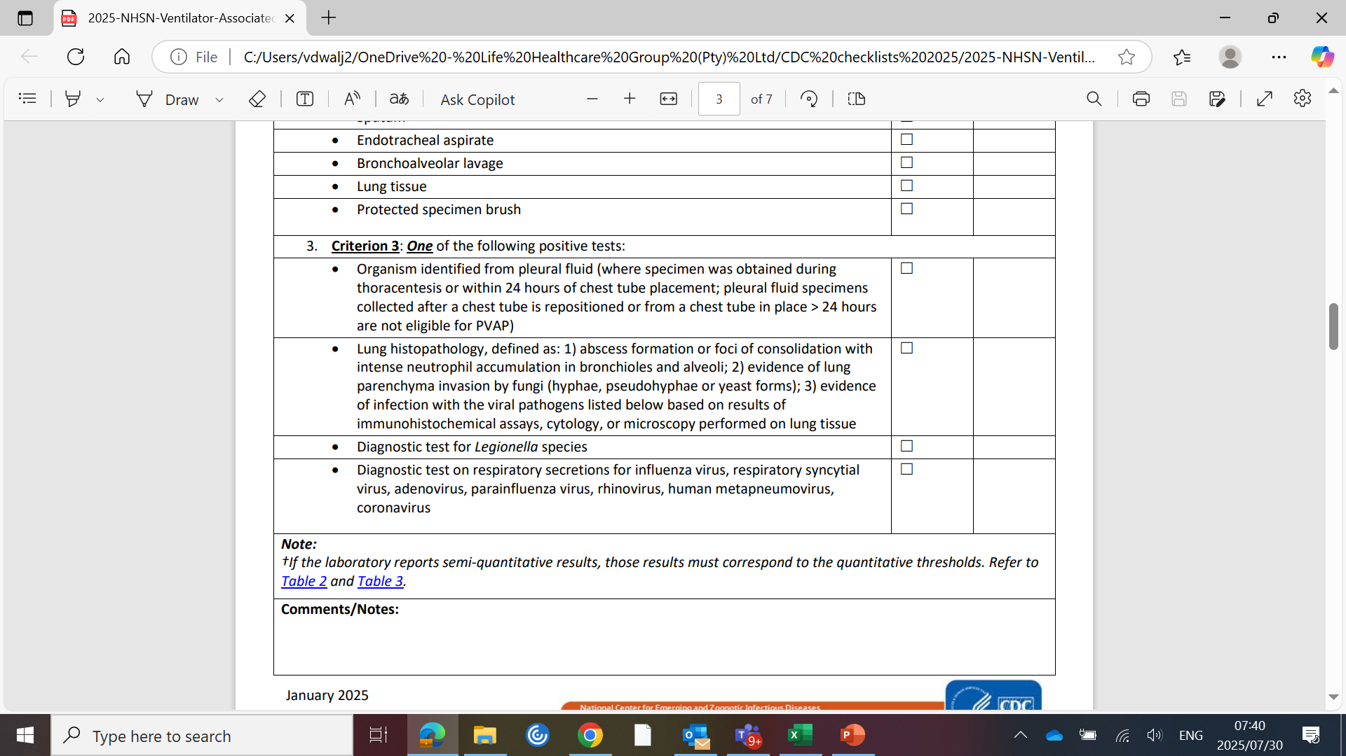
2025 NHSN Ventilator-Associated Event (VAE) Checklist

Slide 19
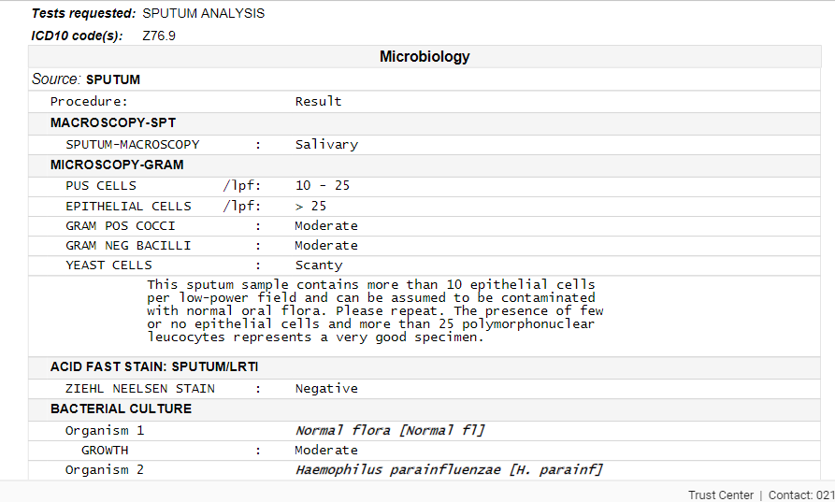

Slide 20
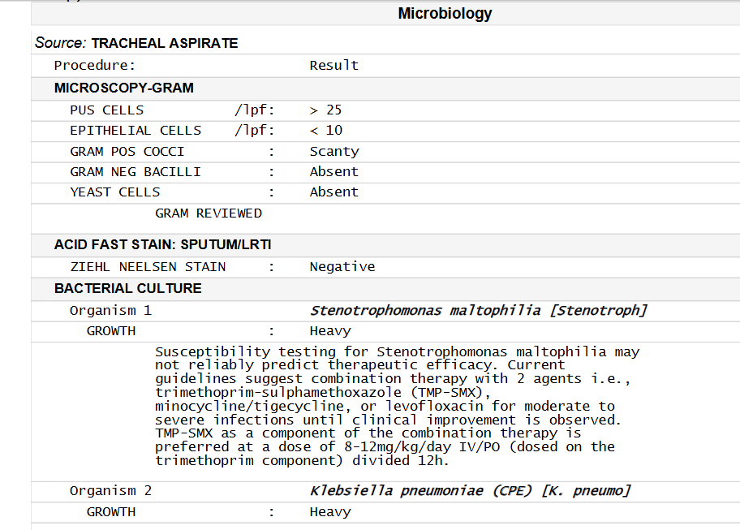
Meets criteria

Slide 21
References
National Healthcare Safety Network . Patient safety component manual
Chapter 10 Pediatric ventilator associated event
Chapter 11 Ventilator associated event January 2025
2025 NHSN Ventilator associated Event (VAE ) checklist
2025 NHSN Pediatric ventilator associated event checklist

